Slide 1


Lesson 12
Nero
UNIT 3

Slide 2
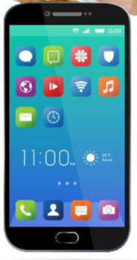
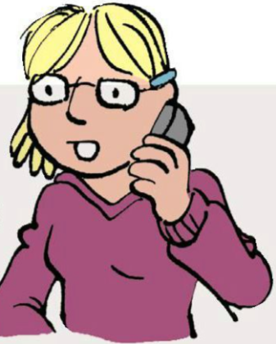
Unscramble the word INGTELNEPHO
The answer is TELEPHONING!
How often do you use a phone?
Do you make phone calls?
What phrases do you use when you phone someone?

Slide 3
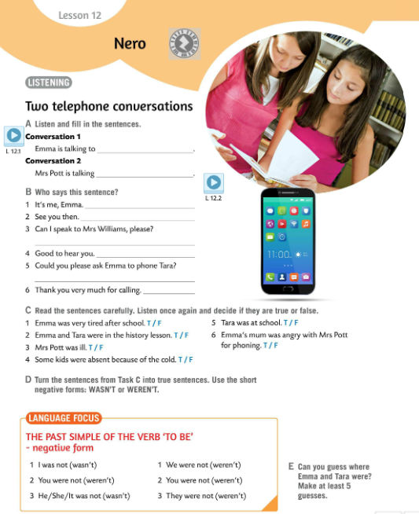

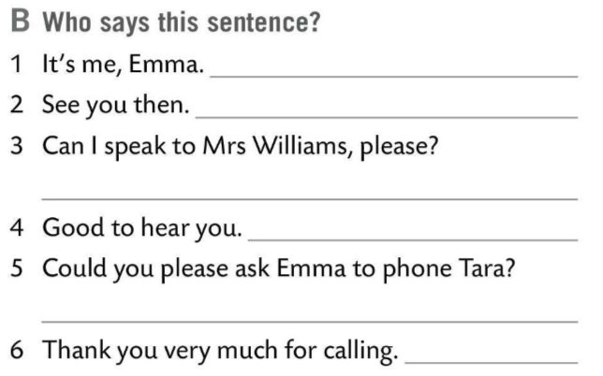
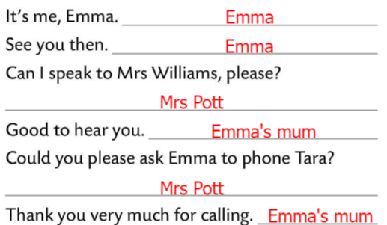
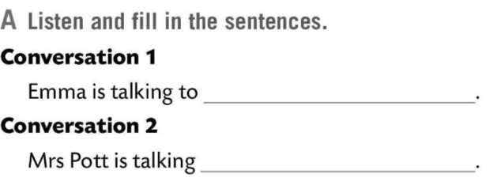
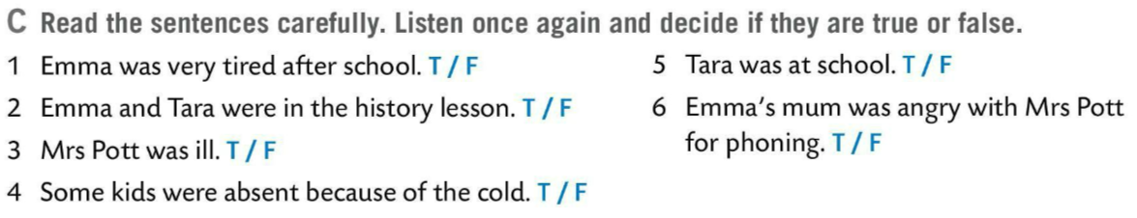

Listen and fill in the first sentence in Task A.
Listen and fill in the second sentence in Task A.
Listen again and check.
her mum
Who says sentences in Task B?
To Emma’s mum/ Mrs Williams
Check.
Read the sentences in Task C carefully. Listen once again and decide if they are true or false.
Check.

Slide 4
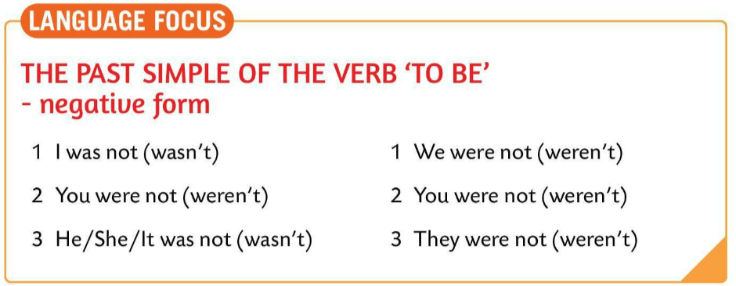
LANGUAGE IN FOCUS
the past simple of the verb ‘to be’ negative form
I was not (wasn’t)
You were not (weren’t)
He/She/It was not (wasn’t)
We were not (weren’t)
You were not (weren’t)
They were not (weren’t)
Turn the sentences in Task C into true sentences.
Use short negative forms: WASN’T or WEREN’T.

Slide 5
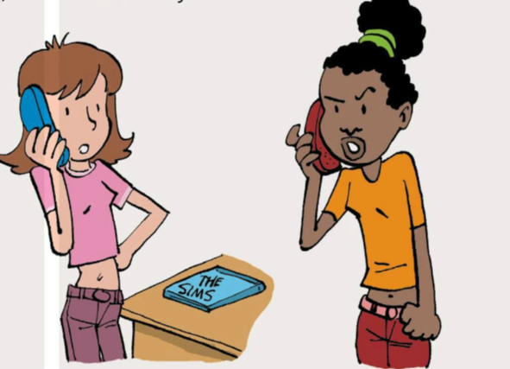
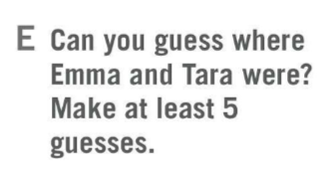
Can you guess where Emma and Tara were?
Make at least five guesses and tell them to the class.
Act out a phone conversation with your partner.
Use the appropriate vocabulary.
For example:
Can I speak to M..., please?
Could you please ask her to…
Thank you very much for calling.
Bye!
Good to hear you.

Slide 6
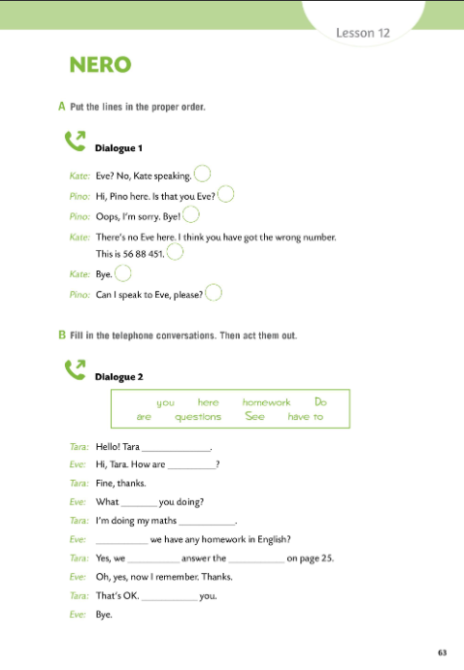

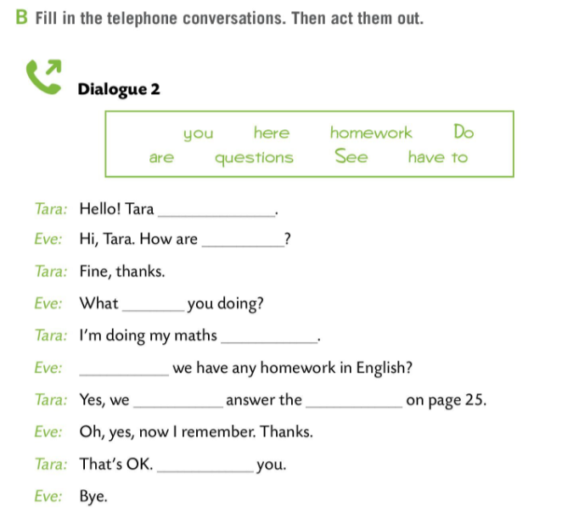
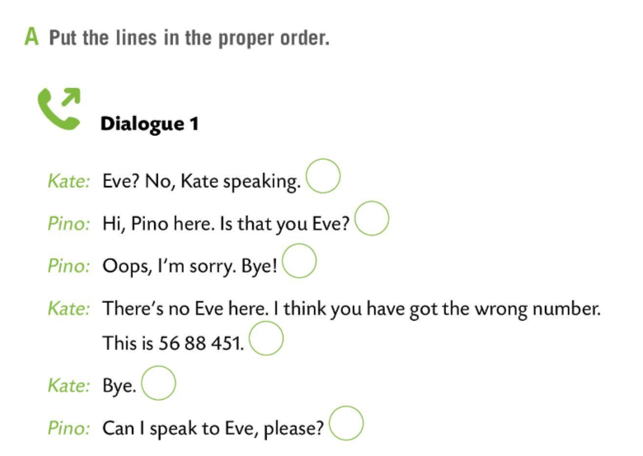
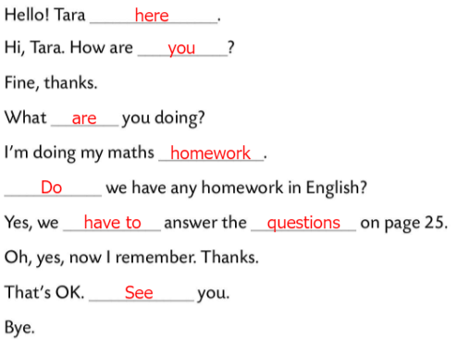
Workbook page 63.
Do Task A. Put the lines in the proper order.
Check.
2
1
5
Fill in the telephone conversations in Task B. Then act them out.
4
6
Check.
3

Slide 7
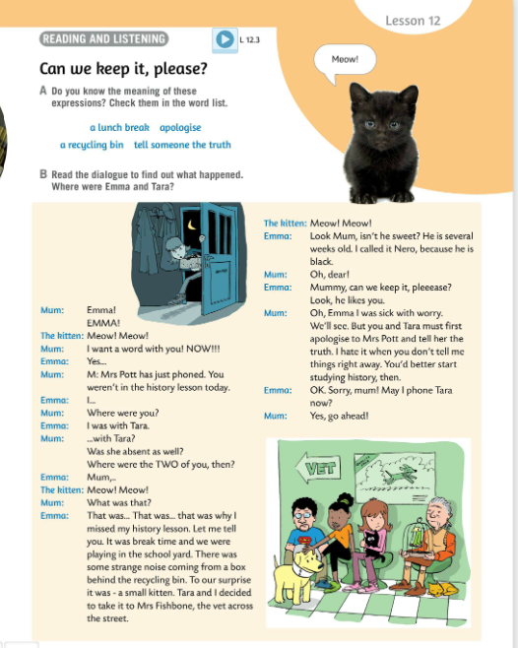
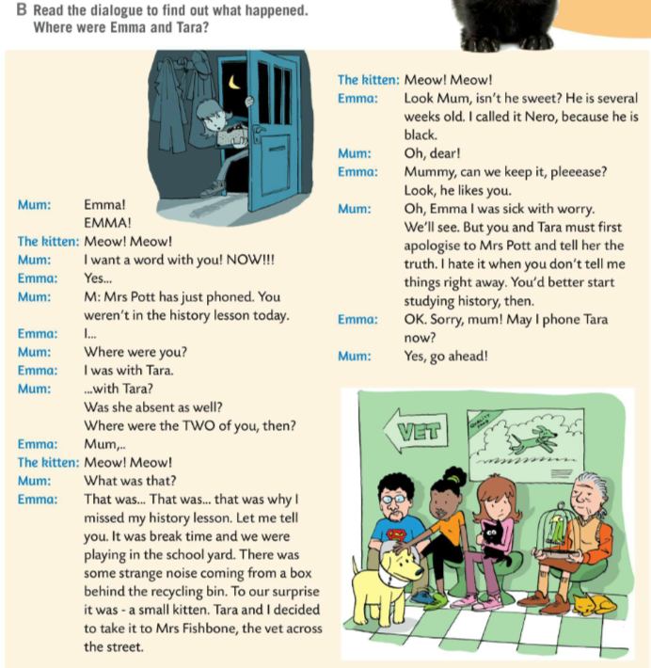

Do you know the meaning of words in Task A?
Check.
a lunch break – stanka za ručak
apologise – ispričati se
a recycling bin – kontejner za recikliranje
tell someone the truth – reći nekome istinu
Listen to the dialogue to find out what happened?
Where were Emma and Tara?
Emma and Tara were at the vet across the street.

Slide 8
Read the text. Practise reading it with your friend.
Underline the past simple of the verb ‘to be’ in positive and negative form.
Ask your teacher for help. Check together.
Write 5 sentences about you or your friends using the past simple of the verb ‘to be’, positive & negative form.
e.g. Damir wasn’t at school at two o’clock yesterday. He was afraid of dogs when he was little. The last history test wasn’t difficult.

Slide 9
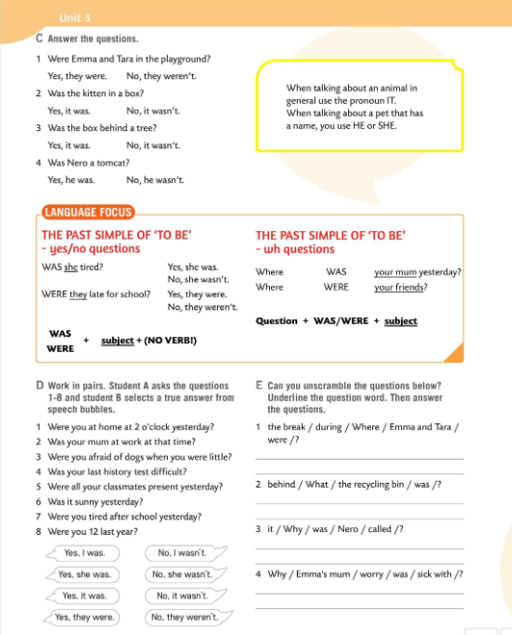
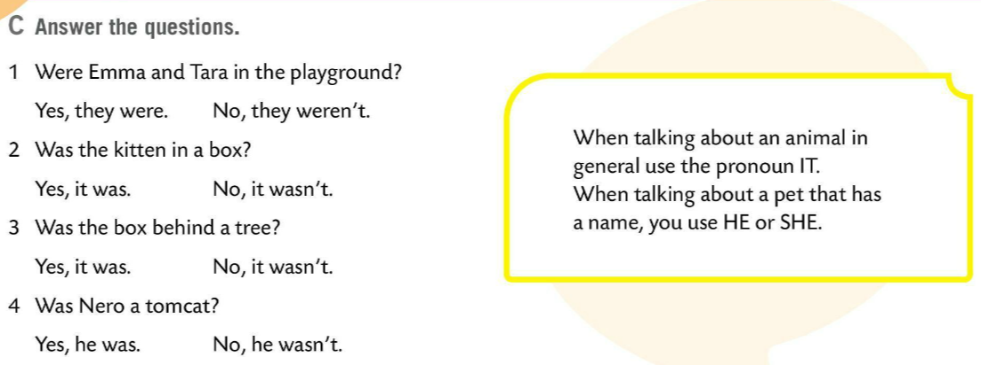
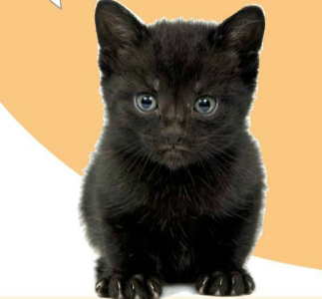
Answer the questions in Task C.
Check.
REMEMBER!
When talking about an animal in general, use the pronoun IT.
ZAPAMTI!
Kada općenito govorimo o životinjama, koristimo zamjenicu IT (ono).
When talking about a pet that has a name, you use HE or SHE.
Kada govorimo o ljubimcu koji ima ime, koristimo zamjenice HE (on) ili SHE (ona).

Slide 10
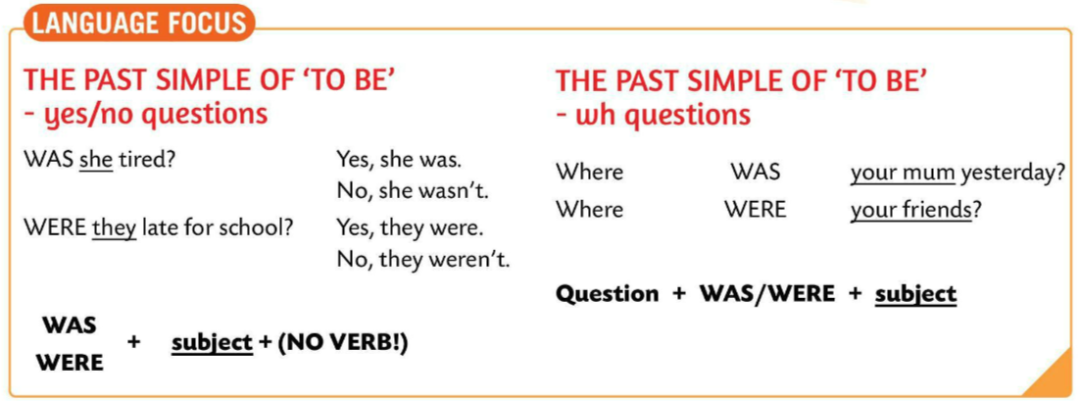
LANGUAGE FOCUS
yes/no questions
WAS/WERE + SUBJECT + (NO VERB!)
Was she tired? – Yes, she was. / No, she wasn’t.
wh- questions
QUESTION WORD + WAS/WERE + SUBJECT
Where was your mum yesterday?
Copy the rules.

Slide 11
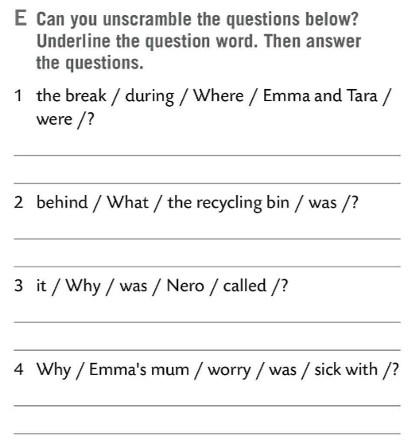
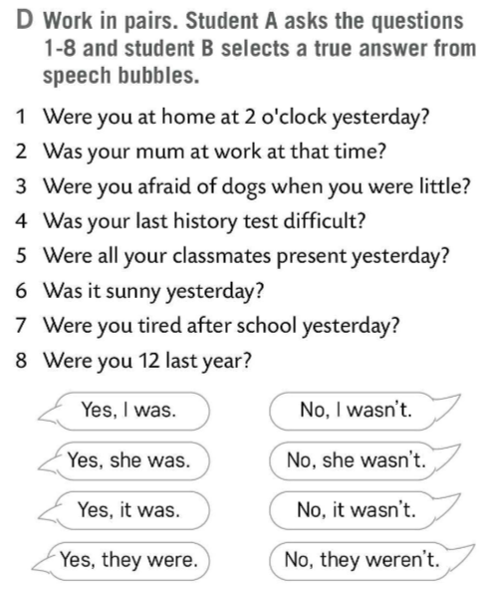
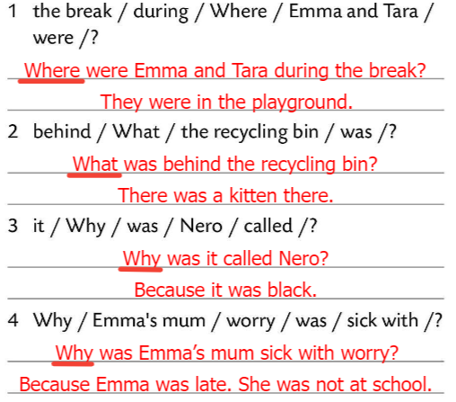
Do Task D. Work in pairs.
Student A asks the questions 1-8.
Student B selects a true answer from speech bubbles.
Unscramble the questions in Task E. Underline the question word. Then answer the questions below.
Check.
Play and learn! https://wordwall.net/play/511/103/337

Slide 12
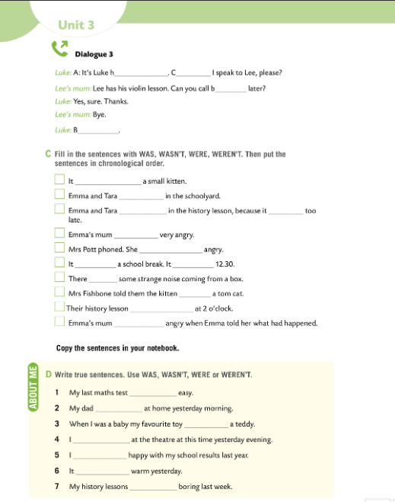
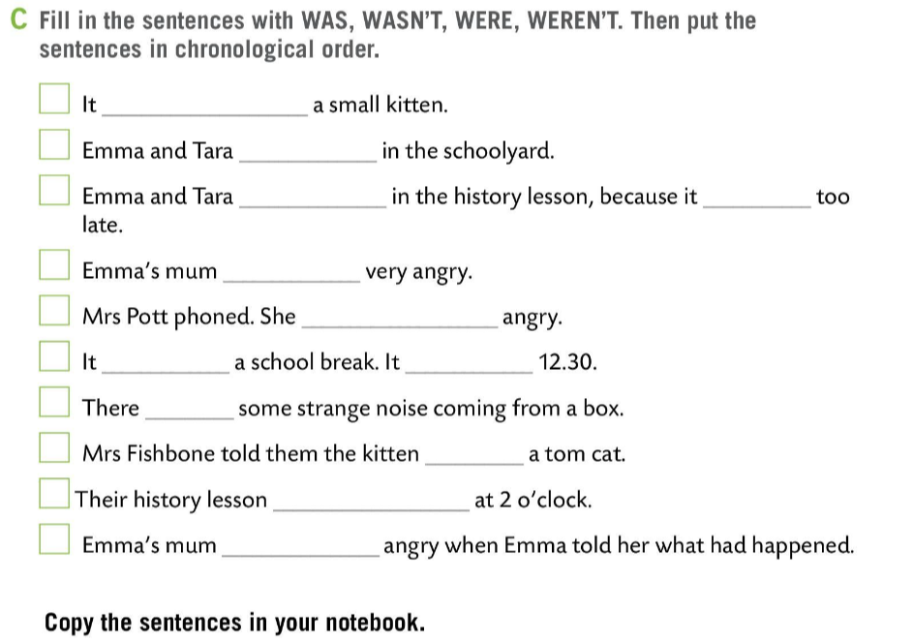
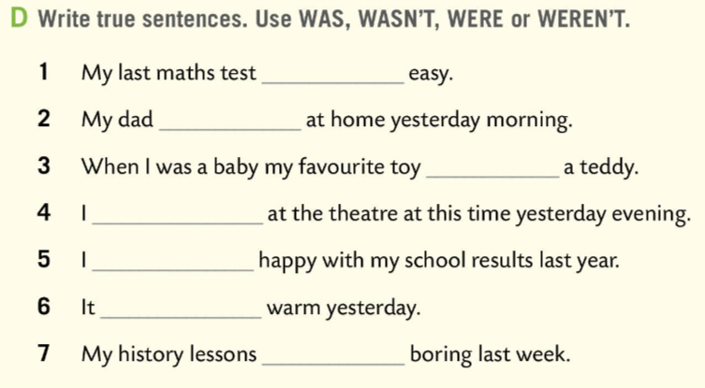
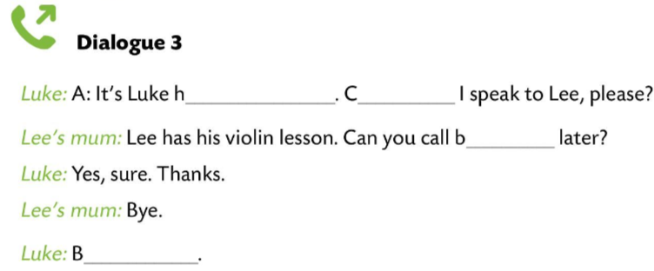
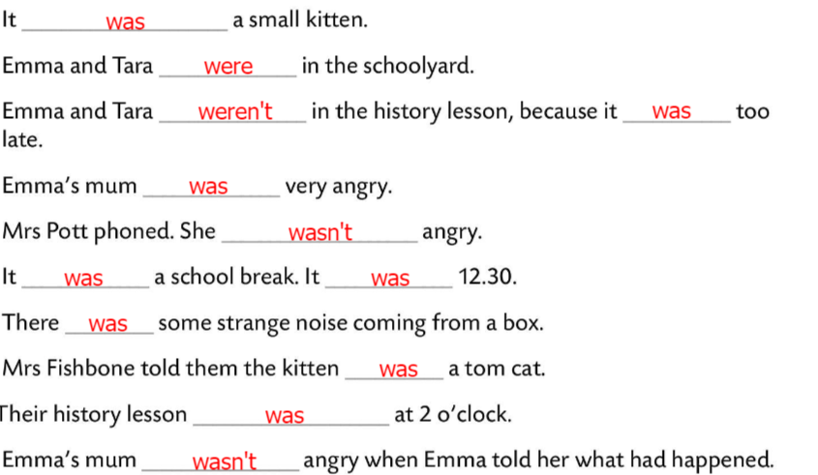
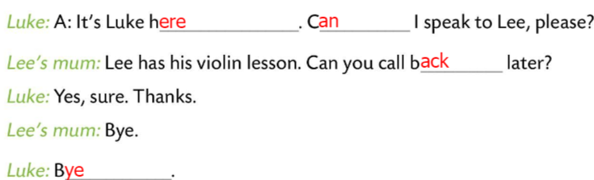
Workbook page 64.
Fill in the telephone conversations in Task B. Act them out.
Check.
Fill in the sentences in Task C with WAS, WASN’T, WERE, WEREN’T.
Put the sentences in chronological order. Copy the sentences.
4
2
6
9
8
1
Check.
3
5
7
Write true sentences in Task D. Use WAS, WASN’T, WERE OR. WEREN’T.
10
Share your answers with the class.

Slide 13
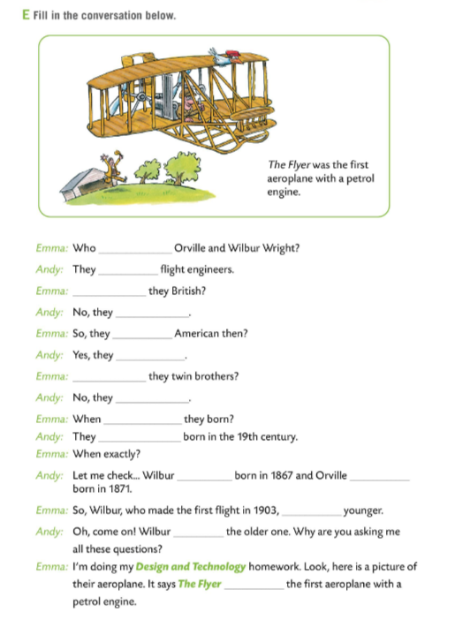
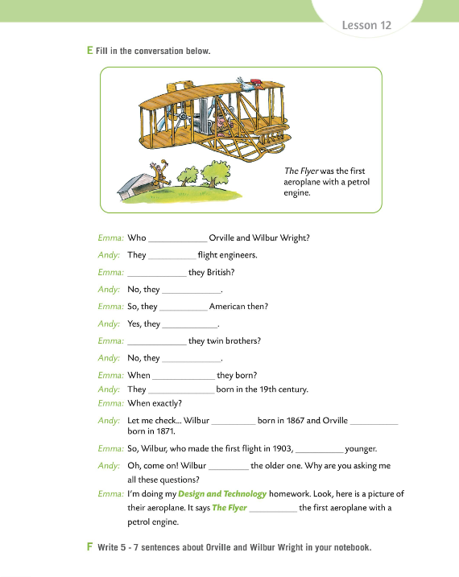
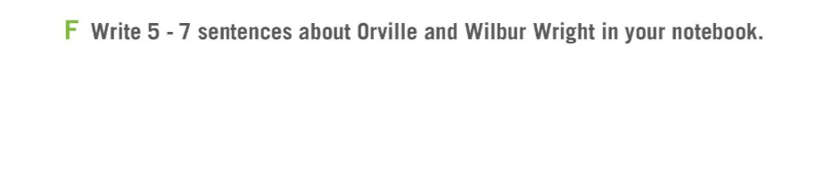
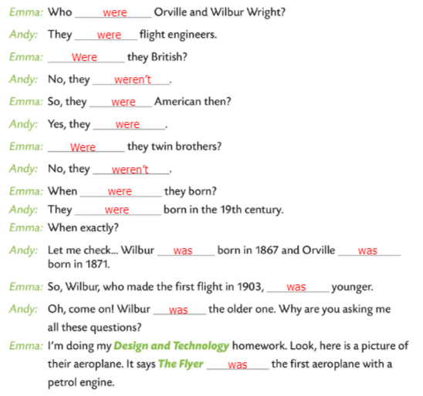
Workbook page 65.
Fill in the conversation in Task E.
Check.
Write five sentences about Orville and Wilbur Wright.
Check.

Slide 14
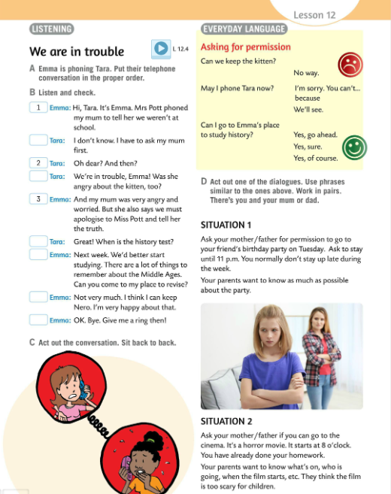
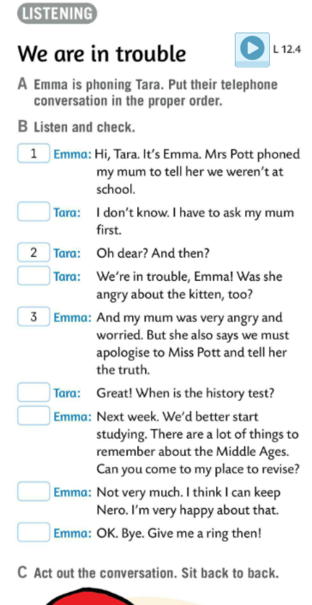
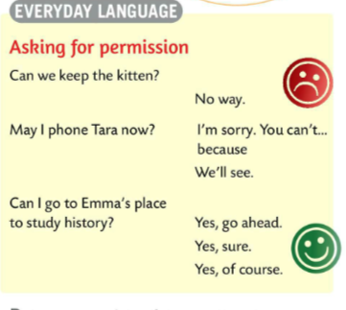
Emma is phoning Tara. Read the dialogue and put their telephone conversation in the proper order.
Listen and check.
8
Listen to the dialogue once again.
Sit back to back. Act out the conversation.
4
EVERYDAY LANGUAGE
We ask for permission when we place
CAN WE…, MAY I… OR CAN I… at the beginning of the sentence.
Tražimo dopuštenje tako što ćemo na početak rečenice staviti izraze poput CAN WE… (Smijemo li), MAY I… OR CAN I… (mogu li ili smijem li…).
6
7
5
9

Slide 15
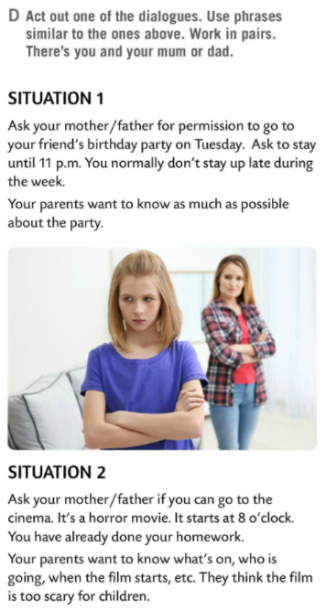
Act out one of the dialogues in Task D.
Use phrases similar to the ones above. Work in pairs. There’s you and your mum or dad.

Slide 16
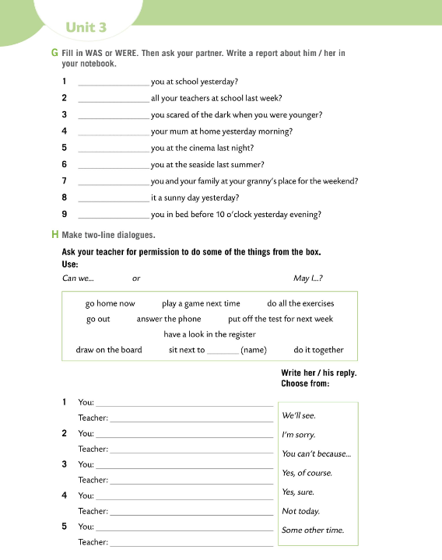
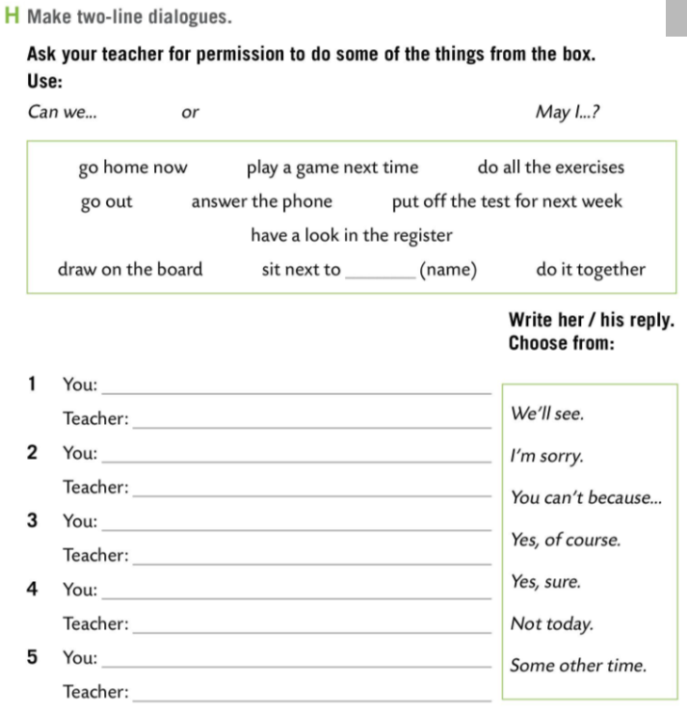
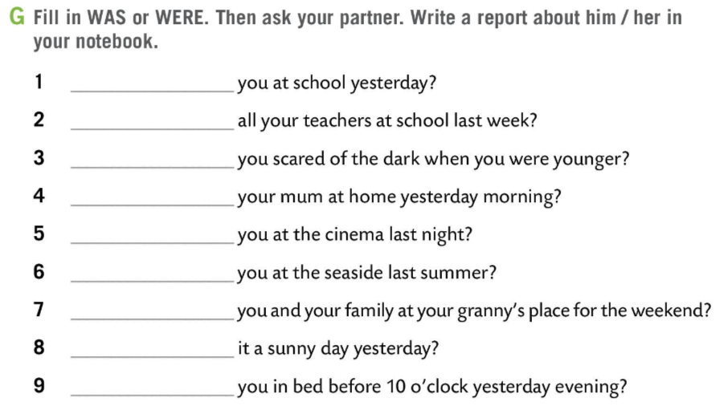
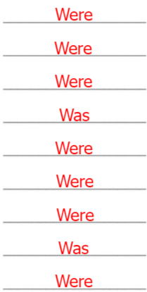
Workbook page 66.
Fill in WAS or WERE. Then ask your partner.
Write a report about him/her.
Check.
Make two-line dialogue.
Read your dialogue in class.

